Slide 1
Implementation and characterization of an open-source plasma plume code
FINAL DEGREE DISSERTATION
Pablo Moreno de Santos
Tutor: Mario Merino Martinez
Degree in Aerospace engineering

Slide 2
INDEX
INTRODUCTION AND MOTIVATION …………………………………….. 3
FAR-REGION MODELLING OF PLUME EXPANSION ………………… 7
ASYMPTOTIC EXPANSION METHOD ……………………………………. 8
SELF-SIMILAR METHOD ……………………………………………………... 11
HYPERPLUME PYTHON CODE ……………………………………………. 13
CHARACTERIZATION OF FAR-REGION PLUMES WITH HYPERPLUME …………………..……………………………………………… 16
CONCLUSIONS …………………………………………………………………. 24
REFERENCES …………………………………………………………………….. 25

Slide 3
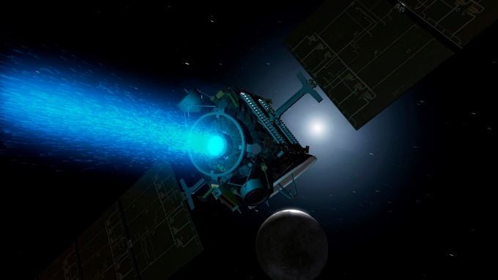
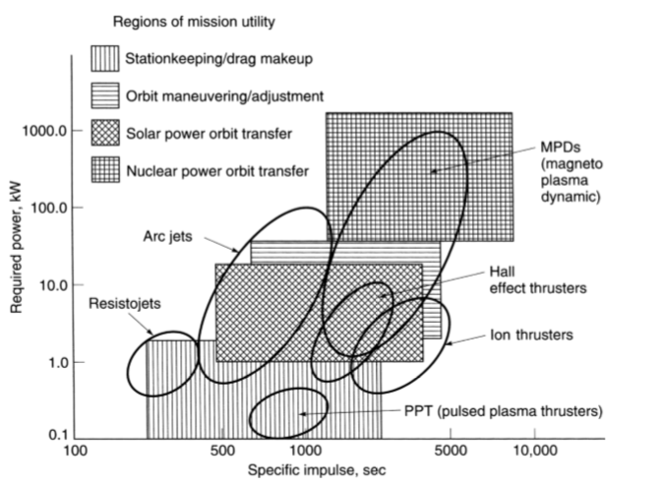
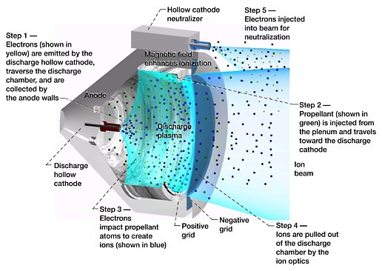
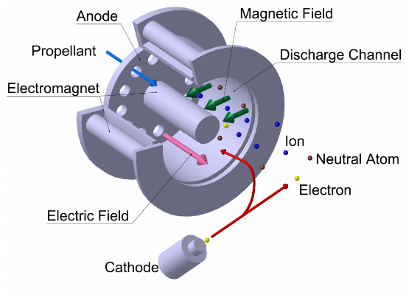

INTRODUCTION AND MOTIVATION
Electric Propulsion vs. Chemical Propulsion: higher Specific Impulse and lower Thrust.
$F=\dot{m}v_{2}=\dot{m}g_{0}I_{sp}$ $I_{sp}= \frac{\int_{0}^{t}{Fdt }}{g_{0}\int_{0}^{t}{mdt}}$
Electric propulsion ideal for GEO and LEO satellite operations (orbit transfers) as well as deep-space applications.
Active areas of investigation in EP: Incremental technologies – Study of exhaust plasma plume expansion outside GIT and HET

Slide 4
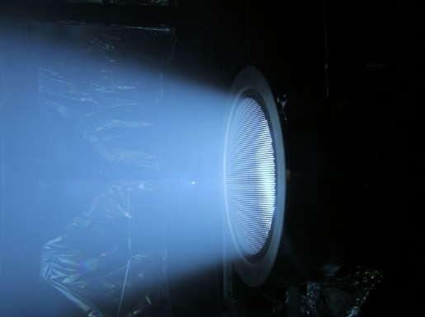
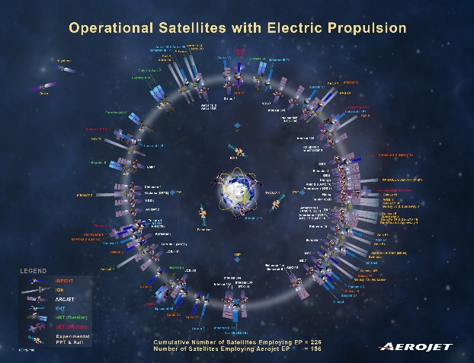
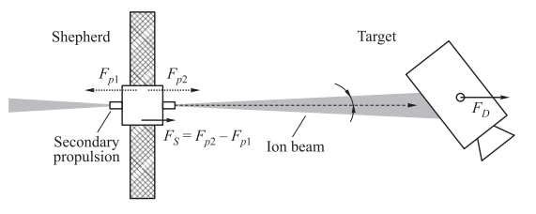
INTRODUCTION AND MOTIVATION
Plasma plumes: Ionized gas propellant expelled from electric thrusters at high divergence angles.
Potential Problems: big concern for spacecraft integrators due to the loss of propulsive momentum and plasma-spacecraft interaction (sputtering, arc discharges,…) of plumes.
Innovative Applications: Using plasma plumes for Space debris removal.

Slide 5
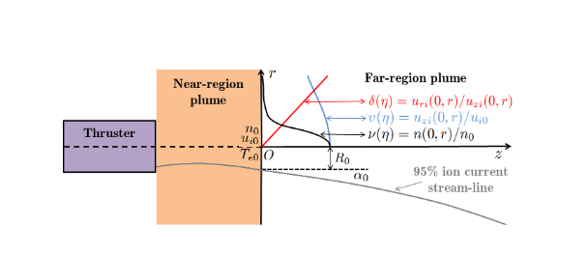
INTRODUCTION AND MOTIVATION
Near-Region and Far-Region plume expansion modelling.
Limited availability of space in-flight data and lab measurement impediments -> Plume modeling.
Near-Region plume expansion: more complex, advance models are needed (PIC)
Far-Region plume expansion: 0.6 – 1 m. out of thruster. Simpler, colisionless and non-magnetic. (Semi-analytical models can be used)
Previous investigations on simple Far-Region plasma plume models were presented in [2]. This dissertation builds upon that work.

Slide 6
INTRODUCTION AND MOTIVATION
Objectives of this dissertation:
Understand and model the physical equations driving a two-fluid, colisionless, and unmagnetized far-region plume expansion.
Inspect two semi-analytical methods in far-region hypersonic plume expansion characterization: the Self-Similar Method (SSM) and the Asymptotic Expansion Method (AEM).
Development of HyperPlume, an Open-Source code written in Python to implement and characterise far-region plume expansions within SSM and AEM theory frameworks.
Inspect the results obtained from HyperPlume and compare them against previous far-region plume expansions codes to check the validity of the Open-Source code.

Slide 7
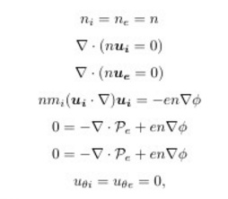
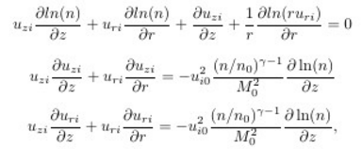
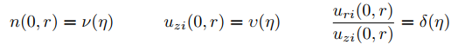

FAR-REGION MODELLING OF PLUME EXPANSION
Far-region plume steady-state two-fluid model equations:
Assumptions
Assumptions: $L≫ λ_{D}$, quasineutral and unmagnetized plume expansion, $P_{e}$ approximated to isotropic tensor, neglect ion thermal pressure and electron inertia…
Hyperbolic Equations: Important parameter is $M_{0}$. Solved under two semi-analytical methods valid for hypersonic plume expansions ($M_{0}≫1$ ): AEM and SSM.

Slide 8
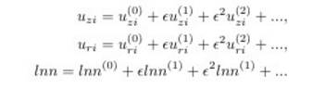
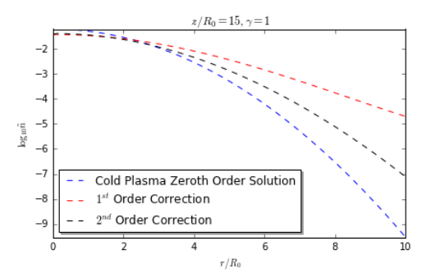
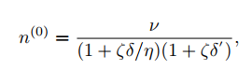
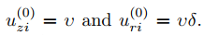

ASYMPTOTIC EXPANSION METHOD
AEM based on perturbation theory and asymptotic expansions about $ε=\frac{1}{M_{0}^{2}}≪1.$ General solution built upon AEM higher order corrections.
Change of reference system, from $\left(z,r\right)$ map to $\left(η,ζ\right),$ returns simpler equations:

Slide 9
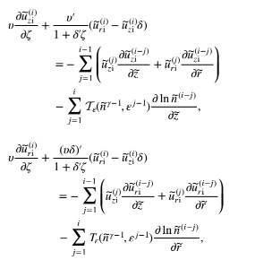
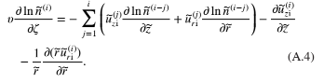

ASYMPTOTIC EXPANSION METHOD
AEM advantages: perturbation terms independent of $M_{0}$ (quick parametric studies), more flexibility in the choice of initial density and velocity profiles.
AEM disadvantages: narrow convergence zone, accuracy depends on higher order corrections (more complex equations).
Improvement: AEM with marching scheme.

Slide 10

ASYMPTOTIC EXPANSION METHOD
AEM re-initialization or marching scheme: AEM integration split into steps or plume fronts. At every plume axial step $z^{j}=const:$
Step plasma plume profiles (density, axial and radial velocity, etc) are used as initial conditions for following steps .
Advantages: No more additional higher order corrections. Increase in accuracy, wider convergence region.

Slide 11
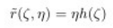
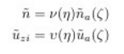
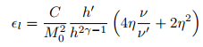
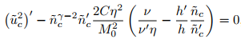

SELF-SIMILARITY METHOD
SSM based on self-similarity of plume expansions: typically smooth, bell-shaped radial plasma profile, invariable along the axial direction with radial broadening.
Very accurate for hypersonic expansions. SSM error proportional to $1/M_{0}^{2}$.
Simpler, but more restrictive than AEM due to model constraints.

Slide 12
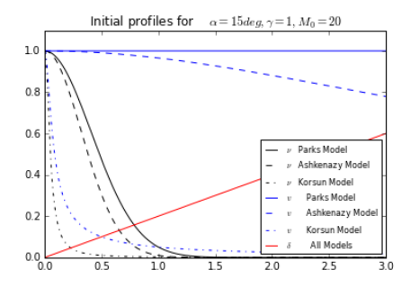
SELF-SIMILARITY METHOD
SSM advantages: algebraically simpler and more accurate than AEM in a wider region; provides important parameters with no need of further processing (ion streamlines).
SSM disadvantages: limited range of initial plasma profiles can be explored accurately.

Slide 13

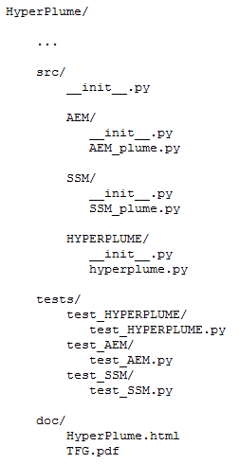
HYPERPLUME PYTHON CODE
How to implement SSM and AEM for numerical integration: Development of HyperPlume Open-Source Python package.
Why Python? High level language. Easy, integrable and powerful. Open-Source programming language for Open-Source code.
HyperPlume Python tool developed under Object-Oriented Programming (OOP) and Test Driven Design (TDD) approaches.
OOP + TDD: code reusability and integrity for possible revisions, fast and easy understanding of the physics behind plume expansion processes, return plume expansion results in a concise manner.

Slide 14
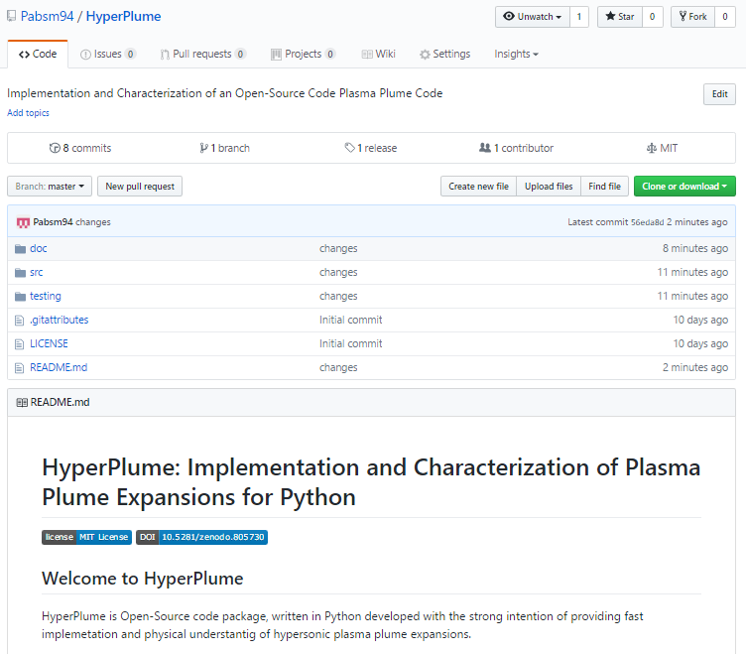
HYPERPLUME PYTHON CODE
Hyperplume Python package released in GitHub Repository.
What is GitHub: web hub for repositories, where all the contents of a particular project are safely stored and versioned.
Code released publicly to academic a non-scholar community. Protect authorship with license and DOI.
https://github.com/Pabsm94/HyperPlume

Slide 15
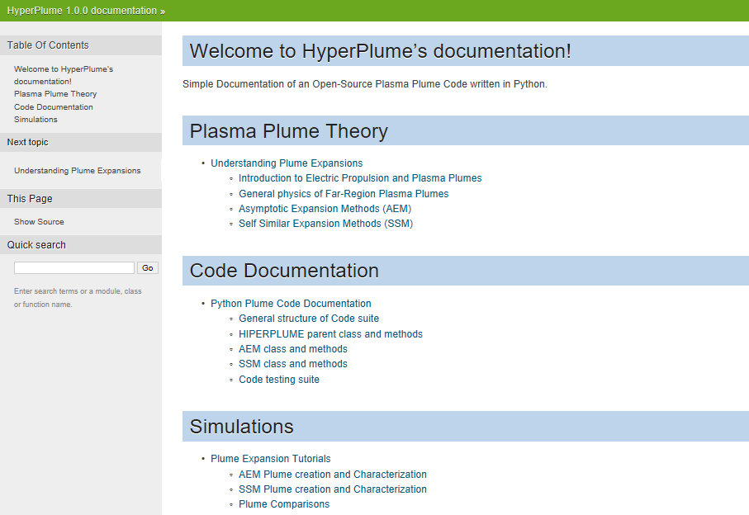
HYPERPLUME PYTHON CODE
Python additional tools allow quick documentation of the code. Sphinx adds value to the documentation. More interactive and readable. Multiple documentation output formats: PDF, HTML, etc.

Slide 16
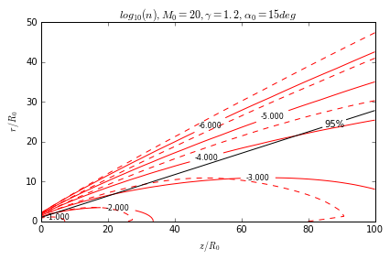
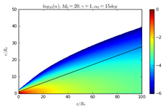
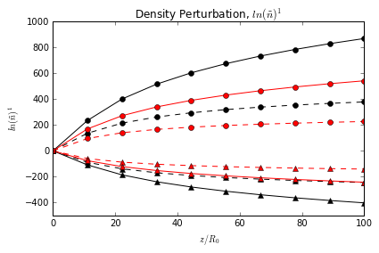
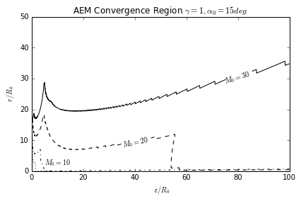

CHARACTERIZATION OF PLUMES WITH HYPERPLUME
AEM results: Influence of γ, $a_{0}$ and $M_{0}$ in plume variables and convergence region.
Findings:
AEM higher order corrections diverge radially and axially downstream.
Accuracy increases with larger $a_{0}$ and γ .
Convergence region of the model and accuracy increase with higher $M_{0}$.

Slide 17
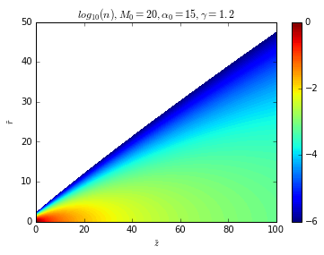
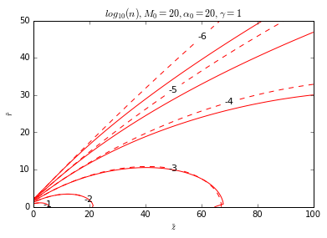
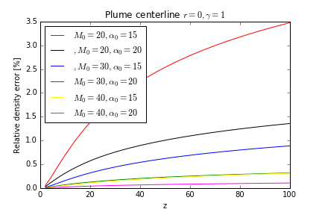
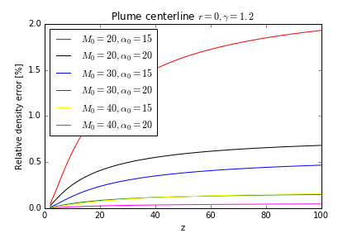

CHARACTERIZATION OF PLUMES WITH HYPERPLUME
Further accuracy gains are achieved with a AEM re-initialization approach:
Findings:
Greater accuracy of results especially downstream.
Difference between simple approach and marching scheme accentuates in critical plume expansion cases , when γ = 1 and low $α_{0}$.

Slide 18
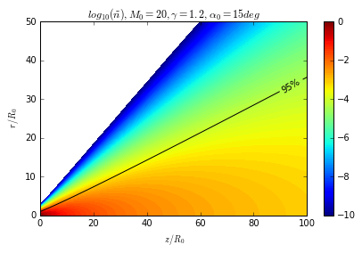
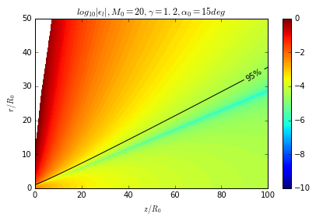
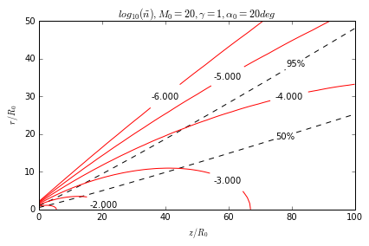
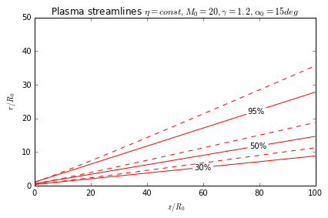


CHARACTERIZATION OF PLUMES WITH HYPERPLUME
SSM results: Influence of γ, $a_{0}$ and $M_{0}$ in plume variables
Findings:
More accurate results with increasing $M_{0}$.
$α_{0}$ and $γ$ influence SSM results slightly. Accuracy increases with lower divergence angle and higher $γ$.

Slide 19
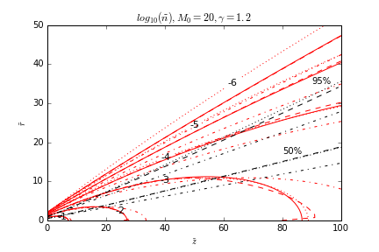
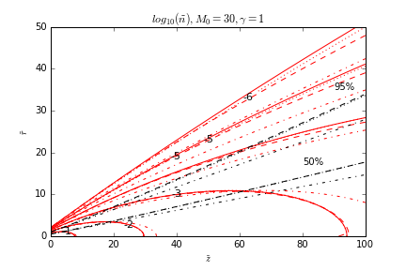
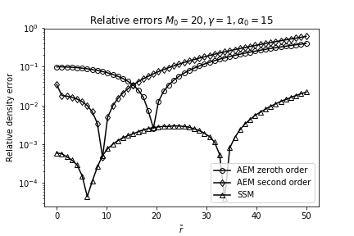
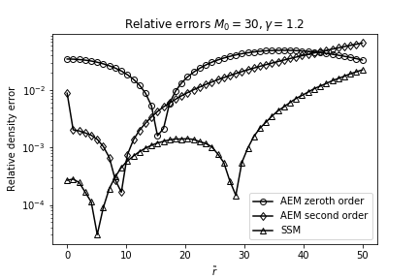

CHARACTERIZATION OF PLUMES WITH HYPERPLUME
Comparison between AEM (no re-initialization) and SSM plume:
Findings:
AEM better suited at short distances; SSM more accurate further downstream.
Both methods are comparable above $M_{0}≫25,30$.
SSM results are more accurate along plume axis, regardless of $M_{0}$.
AEM higher order corrections fall out of the convergence zone at ample radius values from plume centerline.

Slide 20
CHARACTERIZATION OF PLUMES WITH HYPERPLUME
Each method has advantages and weaknesses:
AEM: More flexible range of plume expansions can be investigated. Parametric studies are easier since higher order corrections are independent of Mach Number. However, more complex equations, loss of accuracy downstream and narrow convergence zone.
AEM marching scheme: Overcome accuracy limits and narrow convergence zone of simpler AEM method.
SSM: Simpler but more restrictive. Constraints are imposed in the model, so user cannot freely choose both initial density and velocity plume profiles. On the other hand, ion current streamlines can be directly obtained from model equations.

Slide 21
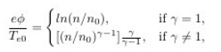
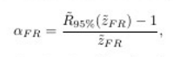

CHARACTERIZATION OF PLUMES WITH HYPERPLUME
Important parameters in the characterization of plume expansions: Ambipolar electric potential $\tilde{φ}$, and Far-Field divergence angle $α_{FR}$.
$\tilde{φ}$ is the mechanism responsible for ion radial acceleration and plume divergence rise.
$\tilde{φ}$ defined as:
Assumptions
$α_{FR}$ is important at design and operation procedure stages: avoid sputtering, rapid estimation of the momentum transferred to a surface downstream (IBS),etc

Slide 22
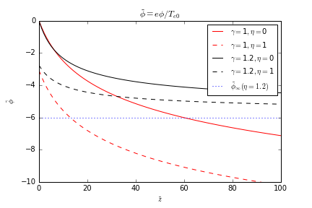

CHARACTERIZATION OF PLUMES WITH HYPERPLUME
Isothermal limit plume expansion yields the unphysical behavior $\tilde{φ}$ -∞ when $\tilde{n}$ 0.
Due to Boltzmann relationship.
On the other hand, if plasma cools down polytropically at a rate $γ>1$, ${\tilde{φ}}_{∞}=−\frac{γ}{γ−1}$
Isothermal and polytropic models diverge after $\tilde{z}=10$

Slide 23
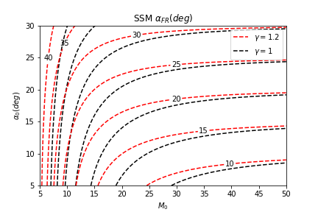

CHARACTERIZATION OF PLUMES WITH HYPERPLUME
Electron pressure becomes negligible and $α_{FR}$ asymptotically approaches $α_{0}$for large values of Mach number $\left(M_{0}>35\right)$.
$α_{FR}$ depends strongly on $M_{0}$ at moderate values ($M_{0}<25)$.
More effective: increase $M_{0}$ rather than reducing $α_{0}$
At any given $M_{0}$ and $α_{0}$, $α_{FR}$ is higher for lower $γ$ values, the electron pressure decaying more slowly closer to the isothermal limit.
$α_{0}$ sets a lower boundary to $α_{FR}$ in the range $[0,{\tilde{z}}_{F}]$

Slide 24

CONCLUSIONS
Investigation of plume expansions is fundamental in the electrical propulsion field. Accessible, fast and simple plume expansion knowledge is needed and benefitial.
Physics of plume expansions can be computationally modeled in Open-Source code. Python proven to be a powerful programming language for academic research.
HyperPlume Open-Source Python tool benefited from OOP and TDD approaches that increase code readability and integrity ,as well as user interaction. HyperPlume offers free access and quick yet accurate results on plume expansion processes.
SSM and AEM Semi-analytical methods developed in HyperPlume are accurate for expansions with $M_{0}≫1.$ Comparison of HyperPlume results against previous far-region plume expansion academic codes shows congruent results.

Slide 25
REFERENCES
George P. Sutton, Oscar Blibarz, Rocket Propulsion Elements,8th edition. Wiley, John Wiley & Sons, Inc,2010.
F. Cichocki ,M.Merino, E.Ahedo, Modeling and Simulation of EP Plasma Plume Expansion into Vacuum at Propulsion and Energy Forum, American Institute of Aeronautics and Astronautic, 50th AIAA/ASME/SAE/ASEE Joint Propulsion Conference, 2014.
F. Cichocki, M.Merino,E.Ahedo, A collisionless plasma thruster plume expansion model. Plasma Sources Science and Technology, IOP Publishing, 2015.
S. H. Lam, MAE 558 Plasmadynamics Notes Department of Mechanical and Aerospace Engineering Princeton University,March 12, 1997
E.J. Hinch. Perturbation methods. Cambridge University Press, 199
Goebel D. and Katz I. 2008 Fundamentals of Electric Propulsion: Ion and Hall Thrusters (New York: Wiley)

